Slide 1
Logistic Regression
Understanding the Formula
Detailed Explaination
Arunkumar Nair

Slide 2
Logistic Regression Equation:
The underlying algorithm of Maximum Likelihood Estimation (MLE) determines the regression coefficient for the model that accurately predicts the probability of the binary dependent variable. The algorithm stops when the convergence criterion is met or maximum number of iterations are reached. Since the probability of any event lies between 0 and 1 (or 0% to 100%), when we plot the probability of dependent variable by independent factors, it will demonstrate an ‘S’ shape curve.

Slide 3
Logit Transformation
Logit Transformation is defined as follows-
Logit = Log (p/1-p) = log (probability of event happening/probability of event not happening) = log (Odds)
Logistic Regression is part of a larger class of algorithms known as GLM (Generlized Linear Model)

Slide 4
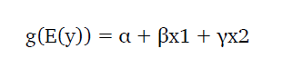
Generalized Linear Model (GLM)
Logistic Regression is part of a larger class of algorithms known as
Generalized Linear Model (GLM).
The fundamental equation of generalized linear model is:

Slide 5
Case-Study Data
We are provided a sample of 1000 customers.
We need to predict the probability whether a customer of a Particular Age will buy (y) a particular magazine or
not.
As we’ve a categorical outcome variable, we’ll use logistic regression.

Slide 6
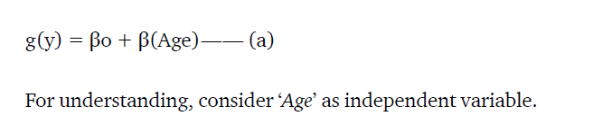
Linear to Logistic – (a)
To start with logistic regression, first write the simple linear regression equation with dependent variable enclosed in a link function:

Slide 7
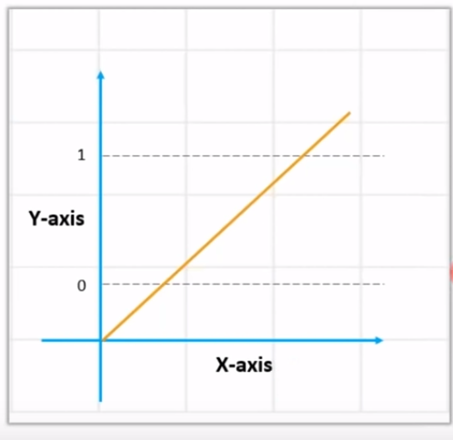
Linear Regression
+ infinity
- infinity

Slide 8
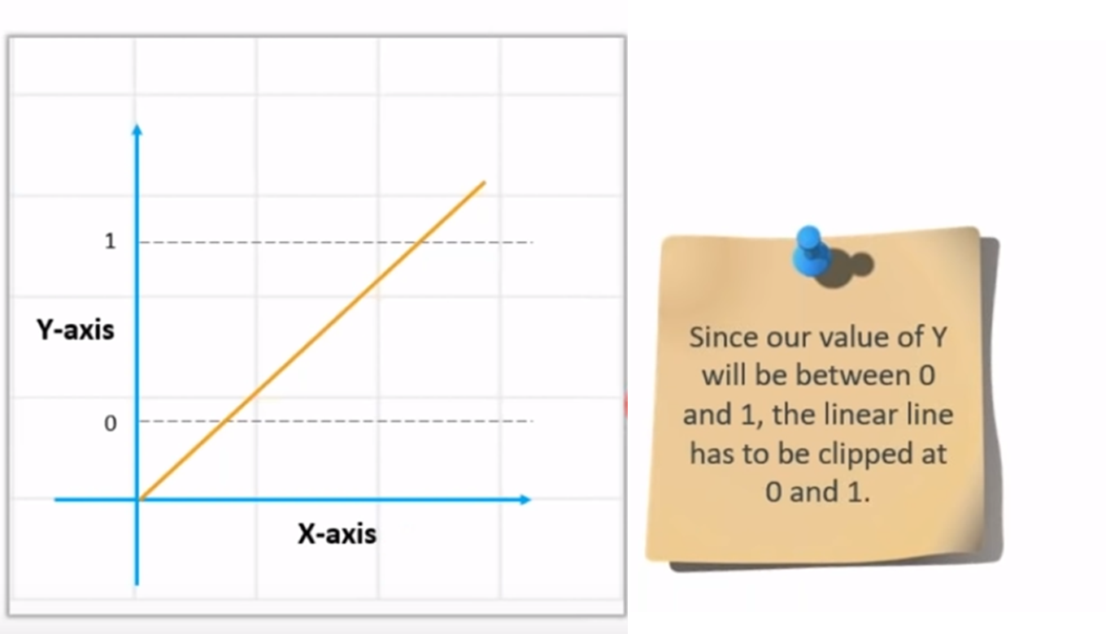
Linear regression equation: y = β0 + β1X1 + β2X2 …. + βnXn

Slide 9
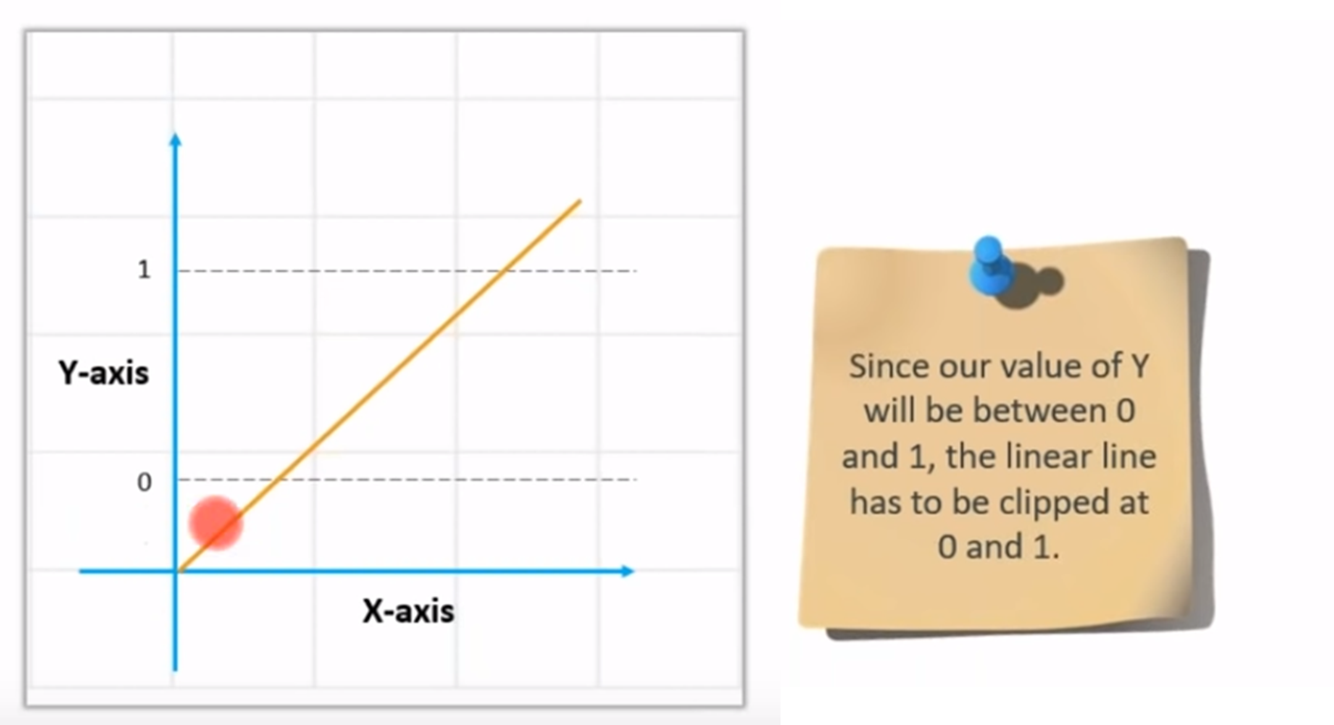
Value of Y – between 0 and 1

Slide 10
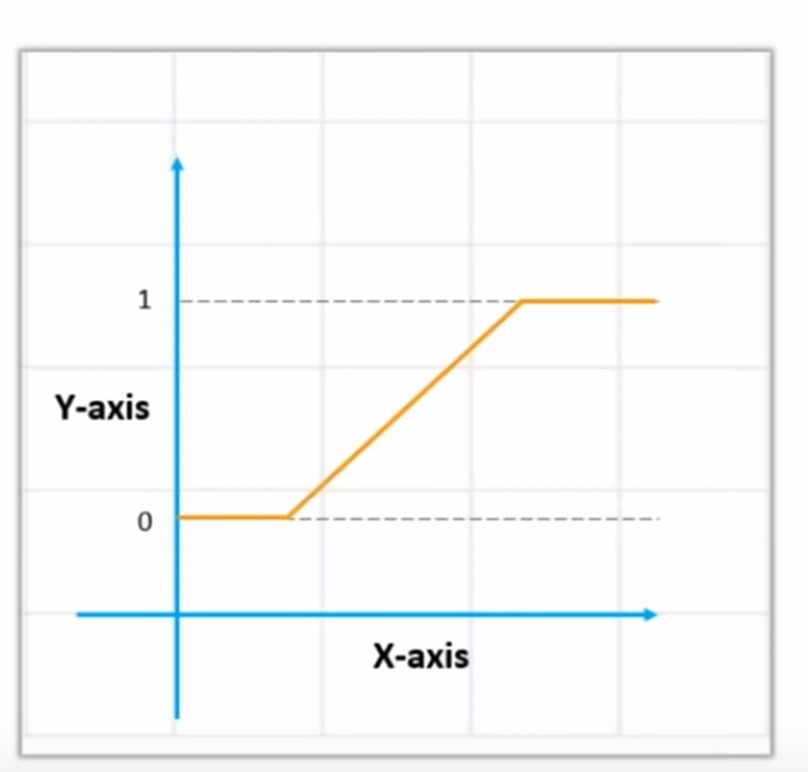
How to get the value of 0 and 1

Slide 11
How to get the value of 0 and 1? Use Sigmoid
We Apply sigmoid function on the linear regression equation to get the S-curve so that it lies between 0 and 1
Sigmoid function: p = 1 / 1 + e^{-y}
A sigmoid function is a mathematical function/equation having a characteristic "S"-shaped curve or sigmoid curve.

Slide 12
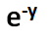
Convert Linear to Logistics
Linear regression equation: y = β0 + β1X1 + β2X2 …. + βnXn
Sigmoid function: p = 1 / 1 + e^{-y}
y is replaced
Logistic Regression equation: p = 1 / 1 + e^{-(β0 + β1X1 + β2X2 …. + βnXn)}

Slide 13
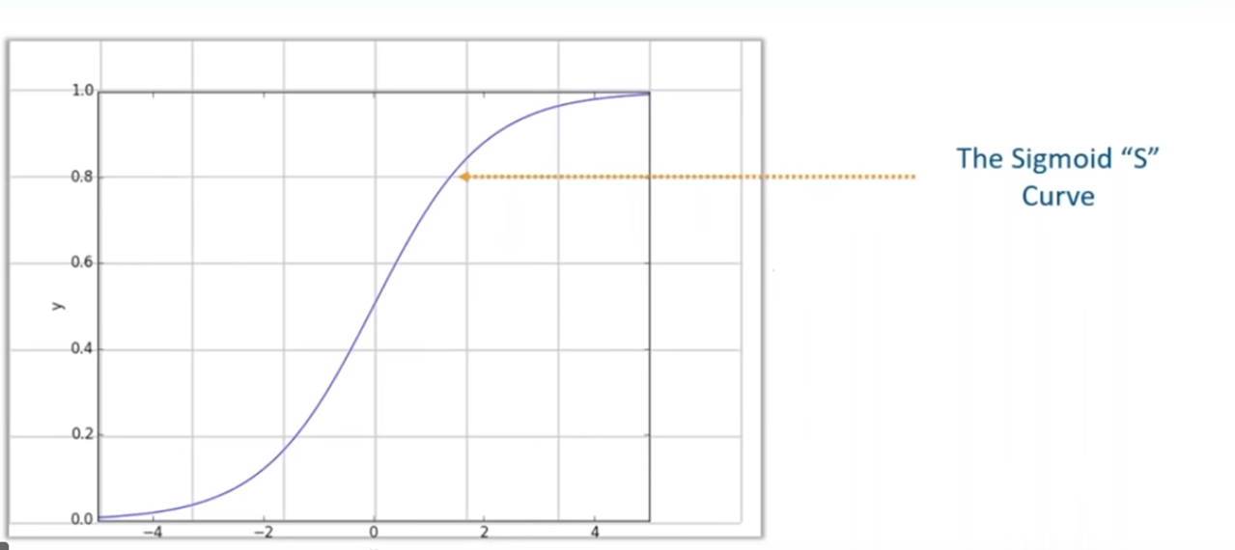
Sigmoid – S-curve

Slide 14
Sigmoid
Sigmoid curve converts any value from
-infinity to +infinity to

Slide 15
Linear Regression
+ infinity
- infinity

Slide 16
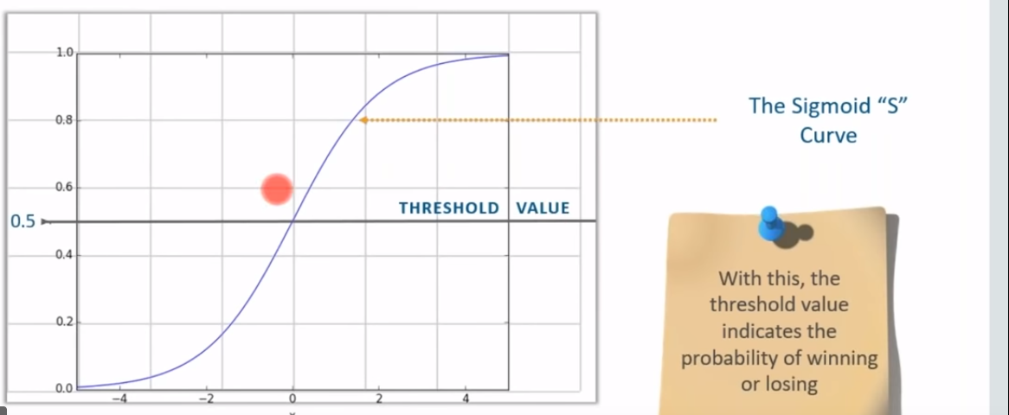
Probability values for the answers
The Threshold value
.8 becomes 1
.2 becomes 0

Slide 17
Thanks
End

Slide 18
Detailing is below

Slide 19
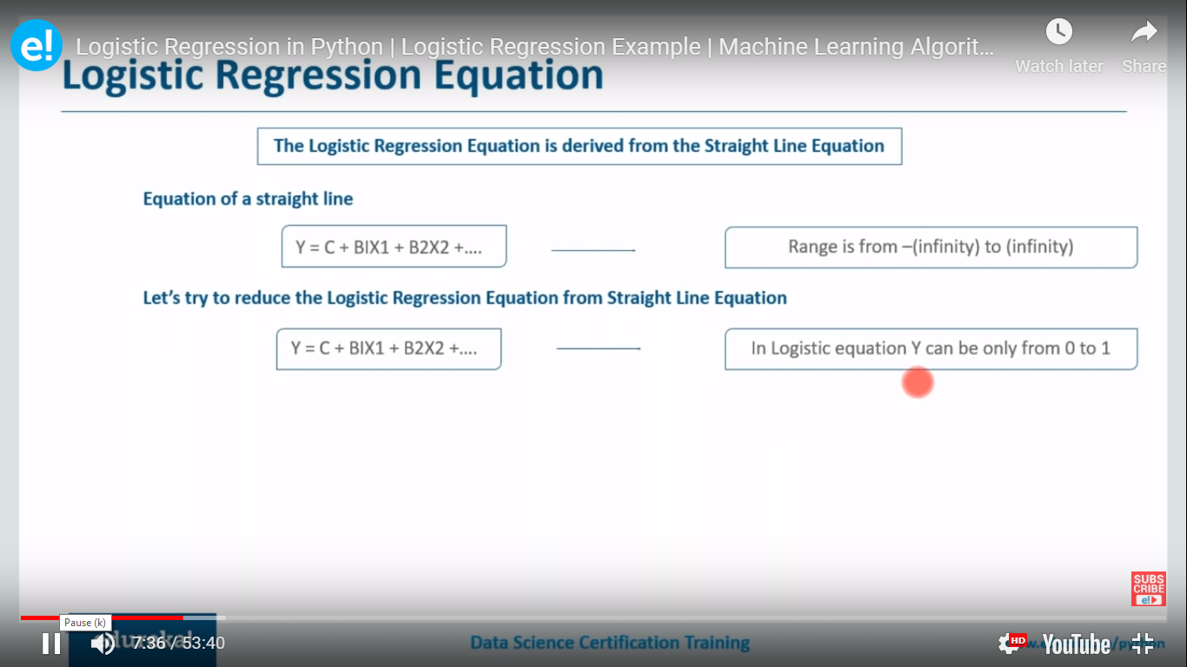
Y value can range from – to +

Slide 20
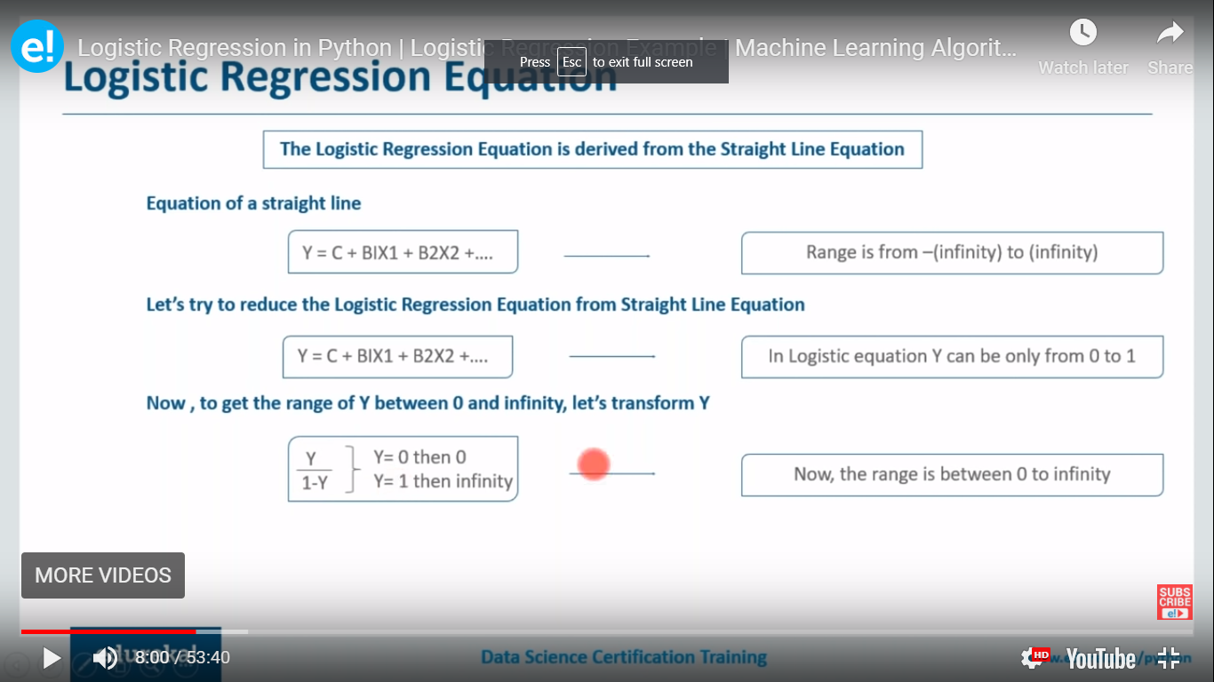

Slide 21
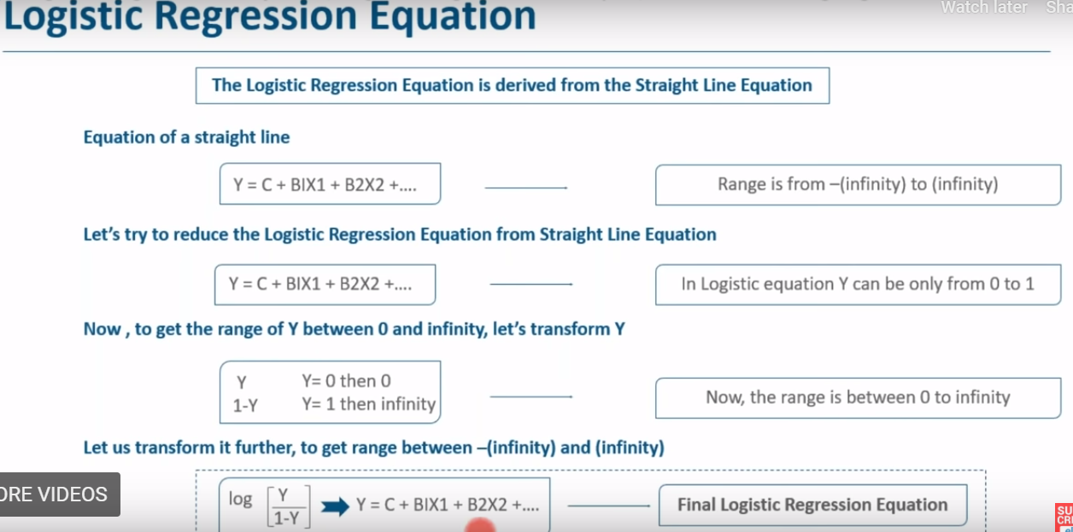

Slide 22
New Slides

Slide 27
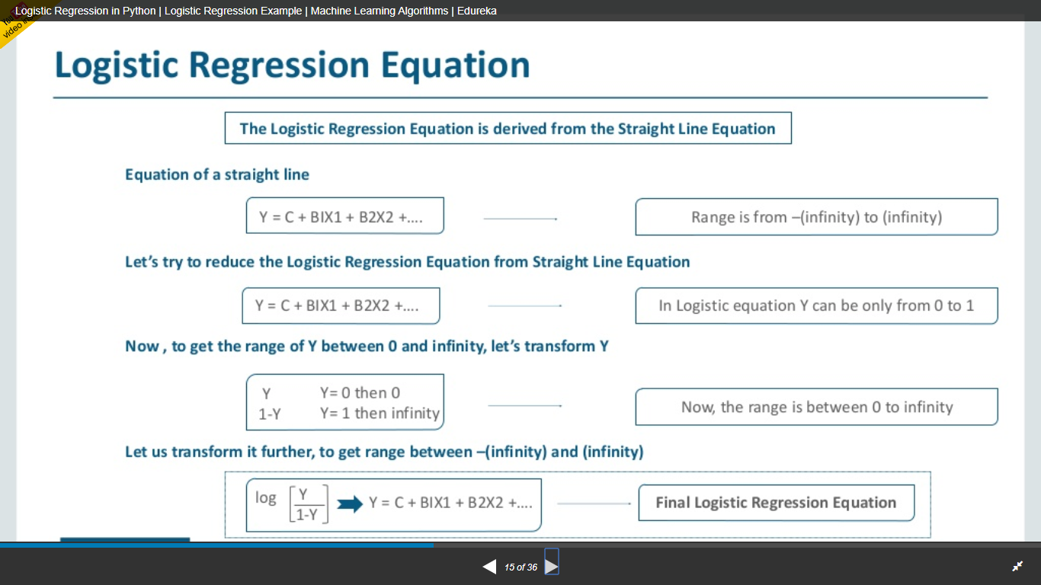

Slide 28
Logistic Regression Equation:
The underlying algorithm of Maximum Likelihood Estimation (MLE) determines the regression coefficient for the model that accurately predicts the probability of the binary dependent variable. The algorithm stops when the convergence criterion is met or maximum number of iterations are reached. Since the probability of any event lies between 0 and 1 (or 0% to 100%), when we plot the probability of dependent variable by independent factors, it will demonstrate an ‘S’ shape curve.

Slide 29
Logit Transformation
Logit means Log(odds)
Logit Transformation is defined as follows-
Logit = Log (p/1-p) = log (probability of event happening/probability of event not happening) = log (Odds)
Logistic Regression is part of a larger class of algorithms known as GLM (Generlized Linear Model)

Slide 30
Generalized Linear Model (GLM)
Logistic Regression is part of a larger class of algorithms known as
Generalized Linear Model (GLM).
The fundamental equation of generalized linear model is:

Slide 31
Case-Study Data
We are provided a sample of 1000 customers.
We need to predict the probability whether a customer of a Particular Age will buy (y) a particular magazine or
not.
As we’ve a categorical outcome variable, we’ll use logistic regression.

Slide 32
Linear to Logistic – (a)
To start with logistic regression, first write the simple linear regression equation with dependent variable enclosed in a link function:

Slide 33
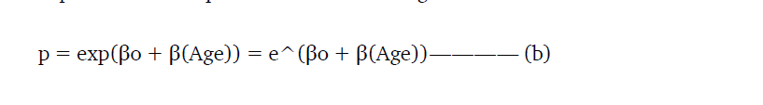
Linear Equation in Exponential Form-(b)
Since probability must always be positive, we’ll put the linear equation
in exponential form. For any value of slope and dependent variable,
exponent of this equation will never be negative.

Slide 34
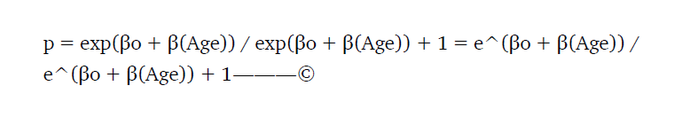
Probability Value has to be Less than 1-©
To make the probability less than 1, divide p by a number greater than p. This can simply be done by:

Slide 35
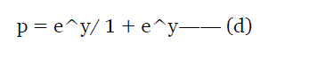
Logit Function –(d)
where p is the probability of success.
This (d) is the Logit Function

Slide 36
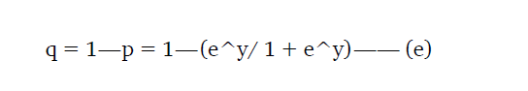
(e)
If p is the probability of success, 1-p will be the probability of failure which can be written as:

Slide 37
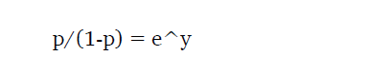
On dividing, (d) / (e)
On dividing, (d) / (e)

Slide 38
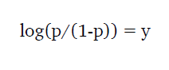
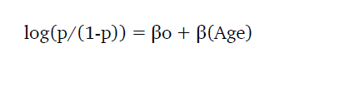
Logarithmic Transformation
After taking log on both side, we get,
This Equation is the link function. Logarithmic transformation on the outcome variable allows us to model a non-linear association in a linear way.
After substituting value of y, we’ll get:

Slide 39
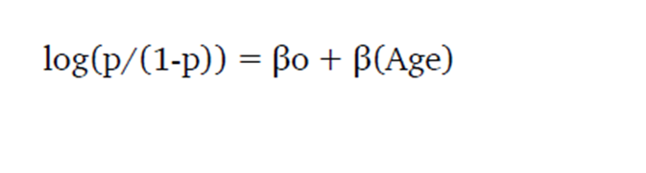
Logistic Regression
This is the equation used in Logistic Regression. Here (p/1-p) is the odd ratio. Whenever the log of odd ratio is found to be positive, the probability of success is always more than 50%. A typical logistic model plot is shown below. It shows probability never goes below 0 and above 1.

Slide 40
Logistic Regression new slides

Slide 41
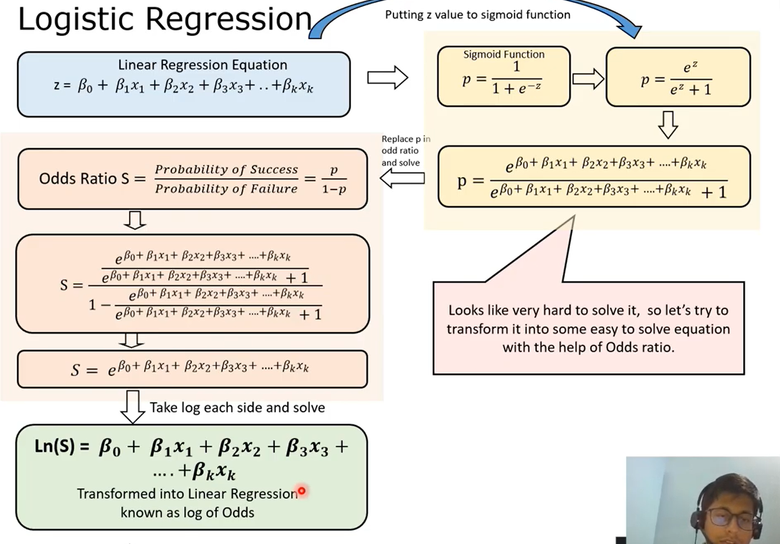
Notes:
https://ashutoshtripathi.com/2019/06/17/logistic-regression-with-an-example-in-r/
https://www.youtube.com/watch?time_continue=67&v=tnHLYnQV6bw&feature=emb_logo

Slide 43
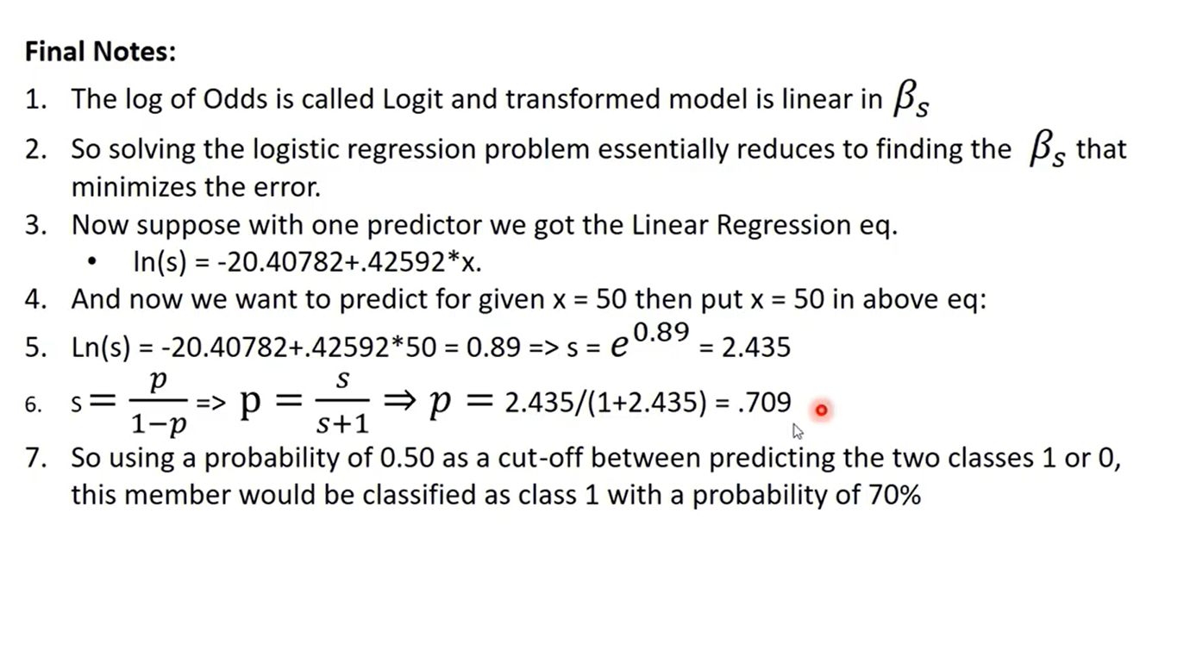

Slide 44
Odds vs Log(odds)

Slide 45
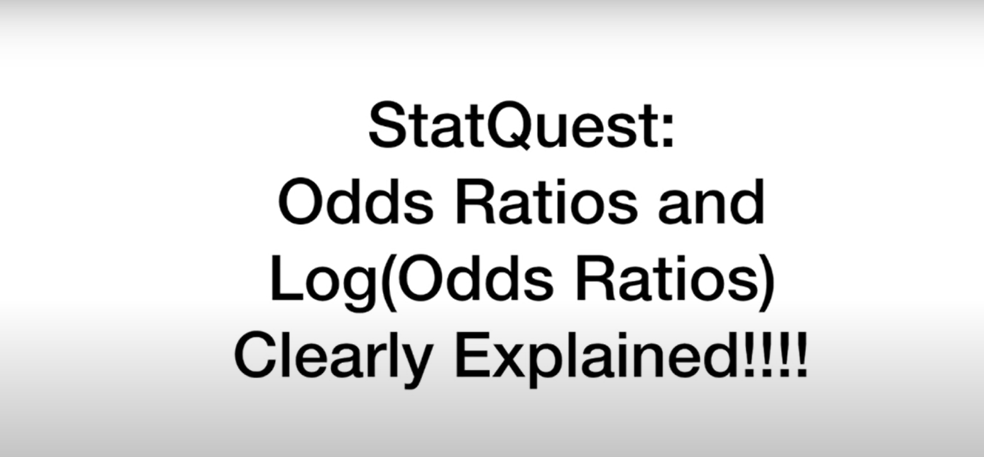
Notes:
https://ashutoshtripathi.com/2019/06/17/logistic-regression-with-an-example-in-r/
https://www.youtube.com/watch?time_continue=67&v=tnHLYnQV6bw&feature=emb_logo

Slide 46
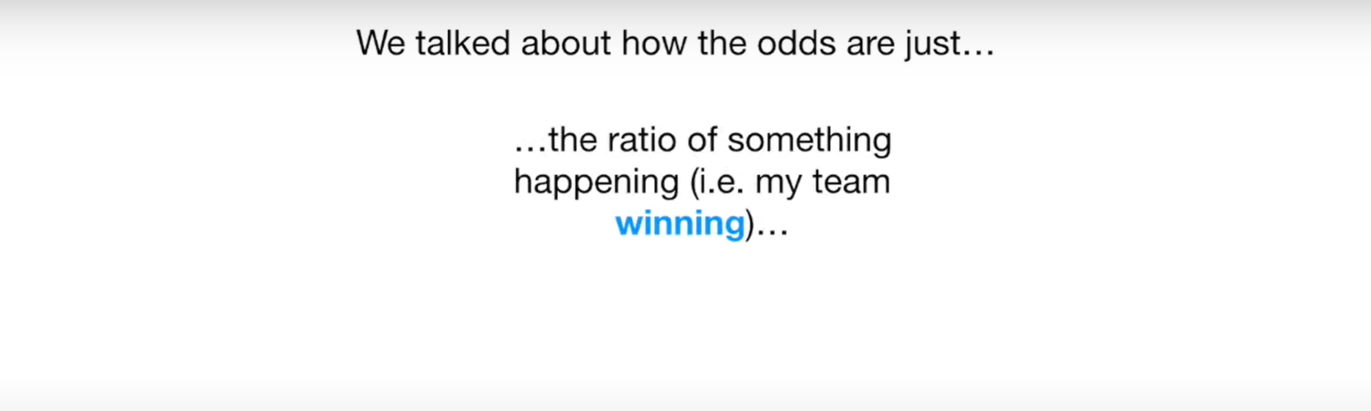

Slide 47
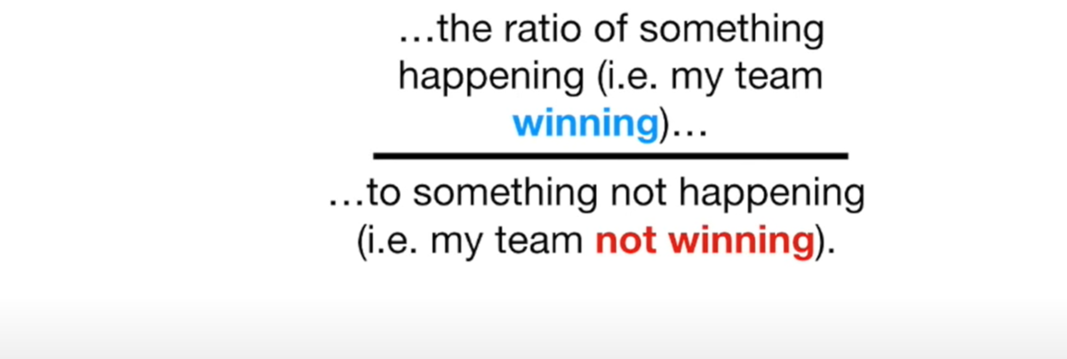

Slide 48
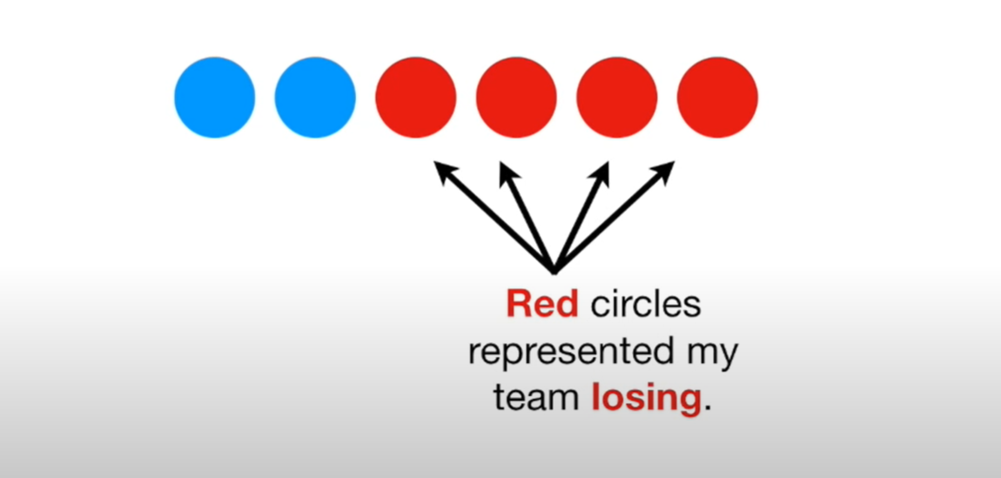

Slide 49
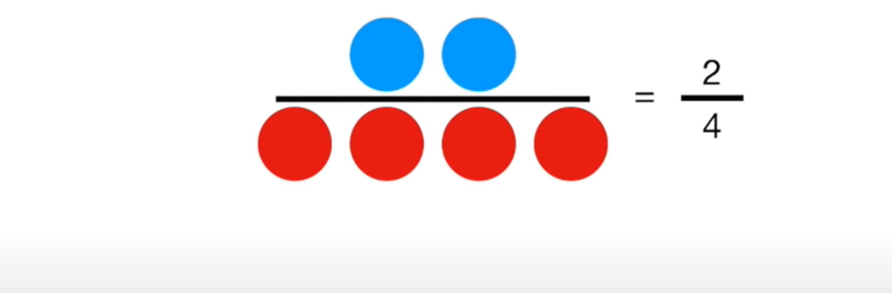

Slide 50
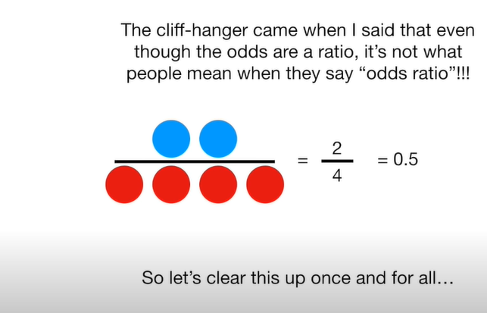

Slide 51
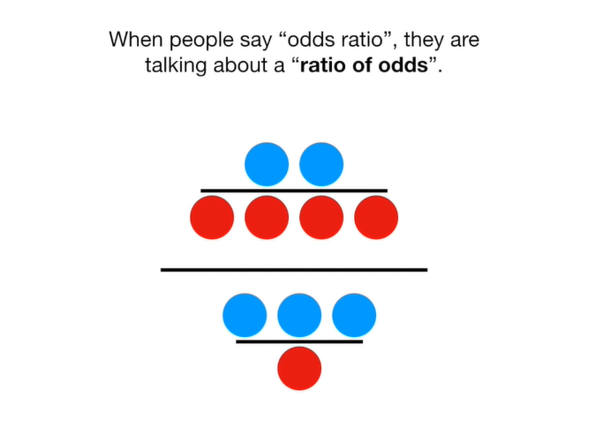

Slide 52
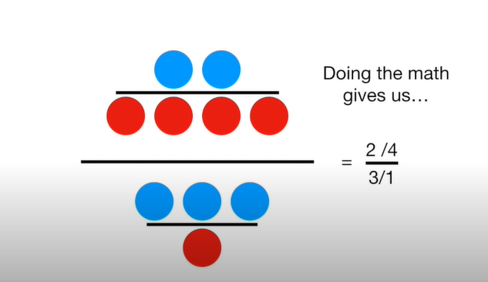

Slide 53
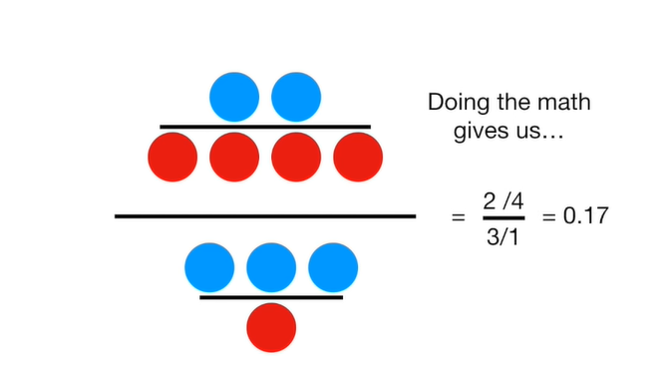

Slide 54
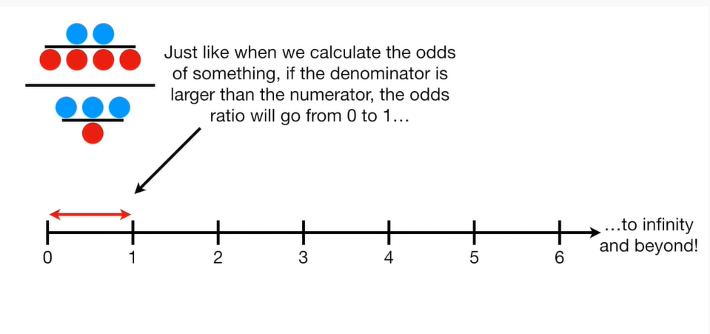

Slide 55
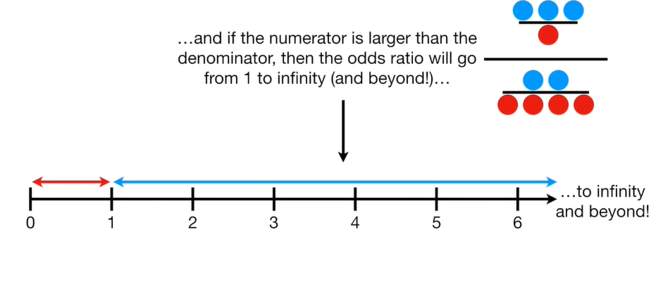

Slide 56
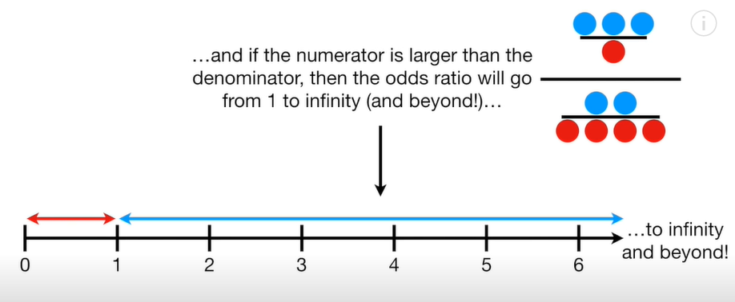

Slide 57
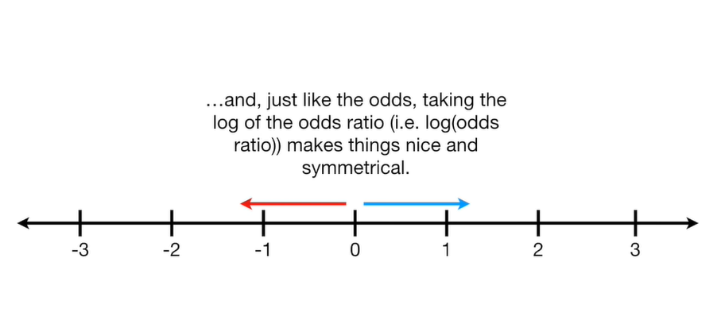

Slide 58
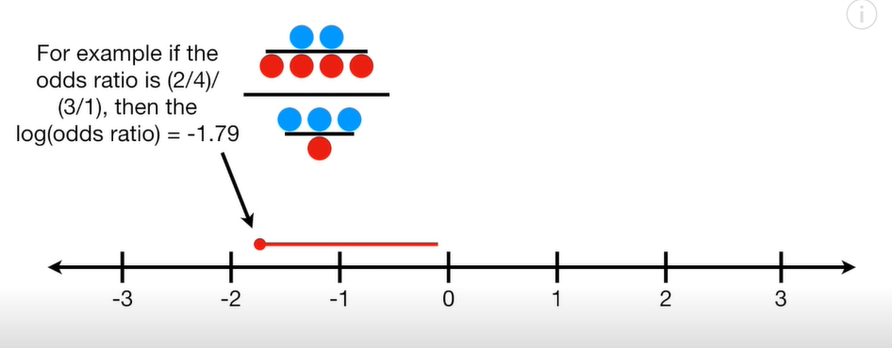

Slide 59
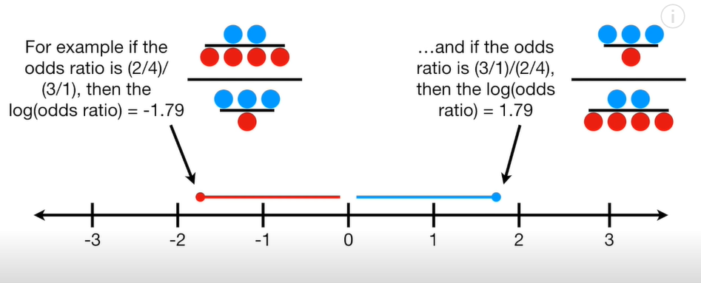

Slide 60
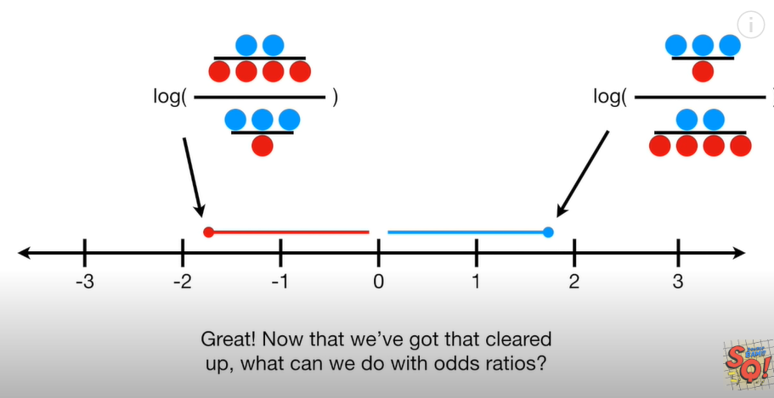

Slide 61
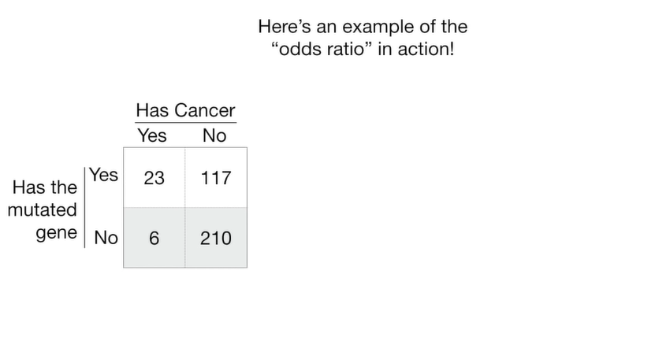
What can we do with Odds Ratio?
Total :356
140 have mutated gene
216 do not have mutated gene
We can use the odds ratio to find the relation ship between mutated gene and cancer. If there is mutated gene is the odds higher that person will have cancer.
Given that a person has a mutated gene , that odds that they have cancer are:
23/117
Given a person does not have a mutated gene, the odds that they have cancer:
6/210
Odds Ratio is :
23/117//6/210 = 0.2/0.03=6.88
Log(odds)Ratio
Log (6.88) =1.93
29
have
cancer
327
Do not
have
cancer
Notes:
See the video:
https://www.youtube.com/watch?v=8nm0G-1uJzA
https://www.stata.com/support/faqs/statistics/odds-ratio-versus-odds/#:~:text=Englishwise%2C%20they%20are%20correct%3A%20it,ratio%20of%20two%20odds%20ratios.

Slide 62
What can we do with Odds Ratio?
Total :356
140 have mutated gene
216 do not have mutated gene
We can use the odds ratio to find the relation ship between mutated gene and cancer. If there is mutated gene is the odds higher that person will have cancer.
Given that a person has a mutated gene , that odds that they have cancer are:
23/117
Given a person does not have a mutated gene, the odds that they have cancer:
6/210
Odds Ratio is :
23/117//6/210 = 0.2/0.03=6.88
Log(odds)Ratio
Log (6.88) =1.93
29 have cancer
327
Do not
have
cancer
Odds ratio
and the log(odds ratio) is
Like R-square.
It tells us the relationship
Between the mutated gene
And cancer. Large values mutated genes is a good predictor of cancer. Small values the mutated Genes is not a Good Predictor of cancer.
Notes:
See the video:
https://www.youtube.com/watch?v=8nm0G-1uJzA
https://www.stata.com/support/faqs/statistics/odds-ratio-versus-odds/#:~:text=Englishwise%2C%20they%20are%20correct%3A%20it,ratio%20of%20two%20odds%20ratios.

Slide 63
What can we do with Odds Ratio?
Total :356
140 have mutated gene
216 do not have mutated gene
Given that a person has a mutated gene , that odds that they have cancer are:
23/117
29
have
cancer
327
Do not
have
cancer

Slide 64
What can we do with Odds Ratio?
Total :356
140 have mutated gene
216 do not have mutated gene
We can use the odds ratio to find the relation ship between mutated gene and cancer
29
have
cancer
327
Do not
have
cancer

Slide 65
What can we do with Odds Ratio?
Total :356
140 have mutated gene
216 do not have mutated gene
We can use the odds ratio to find the relation ship between mutated gene and cancer
29
have
cancer
327
Do not
have
cancer

Slide 66
What can we do with Odds Ratio?
Total :356
140 have mutated gene
216 do not have mutated gene
We can use the odds ratio to find the relation ship between mutated gene and cancer
29
have
cancer
327
Do not
have
cancer

